Slide 1
Programming With Hybris Service Layer
Module - 8

Slide 2
Contents
Architecture of the ServiceLayer
Services
Models
Interceptors
Events

Slide 3
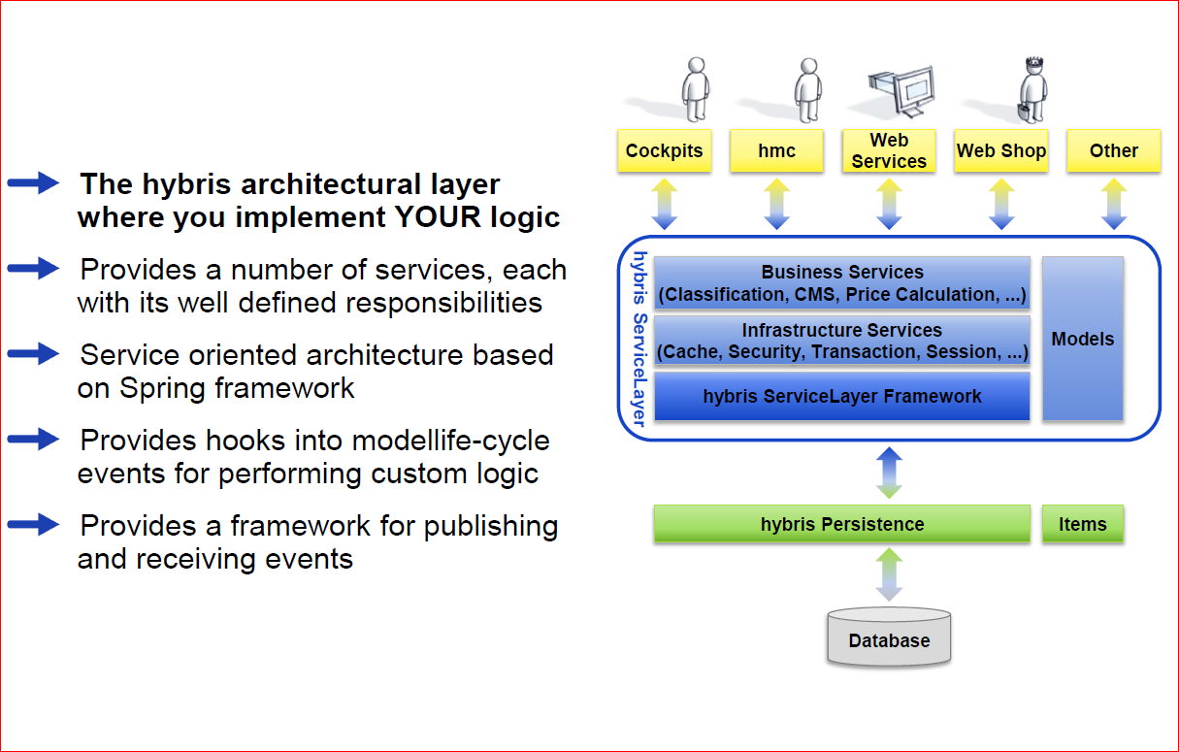
Overview of the hybris ServiceLayer

Slide 4
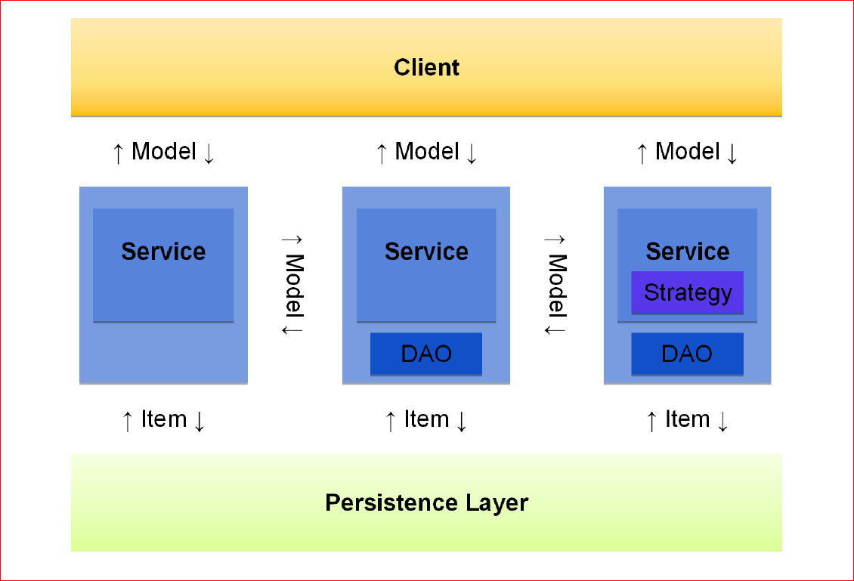
ServiceLayer – Structure and Data Objects

Slide 5
Contents
Architecture of the ServiceLayer
Services
Models
Interceptors
Events

Slide 6
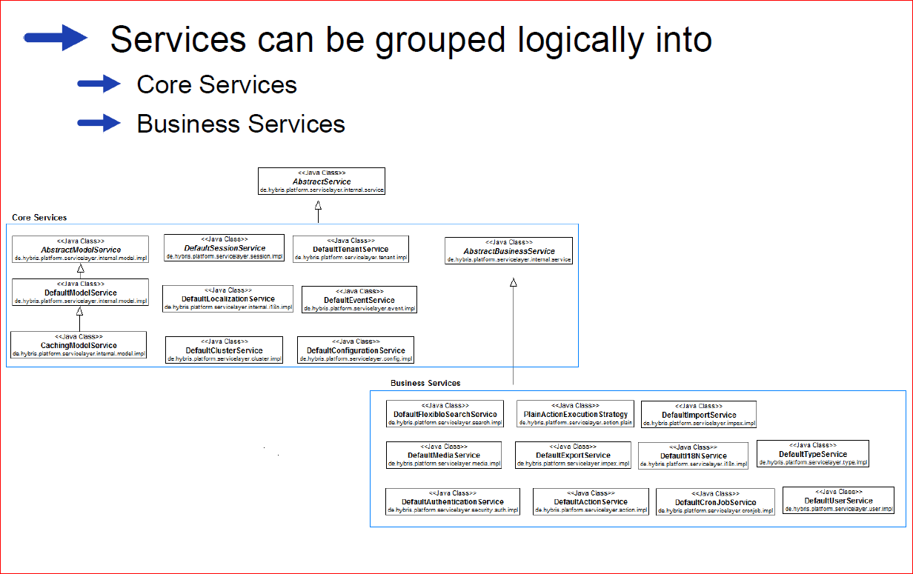
What Services Are There?

Slide 7
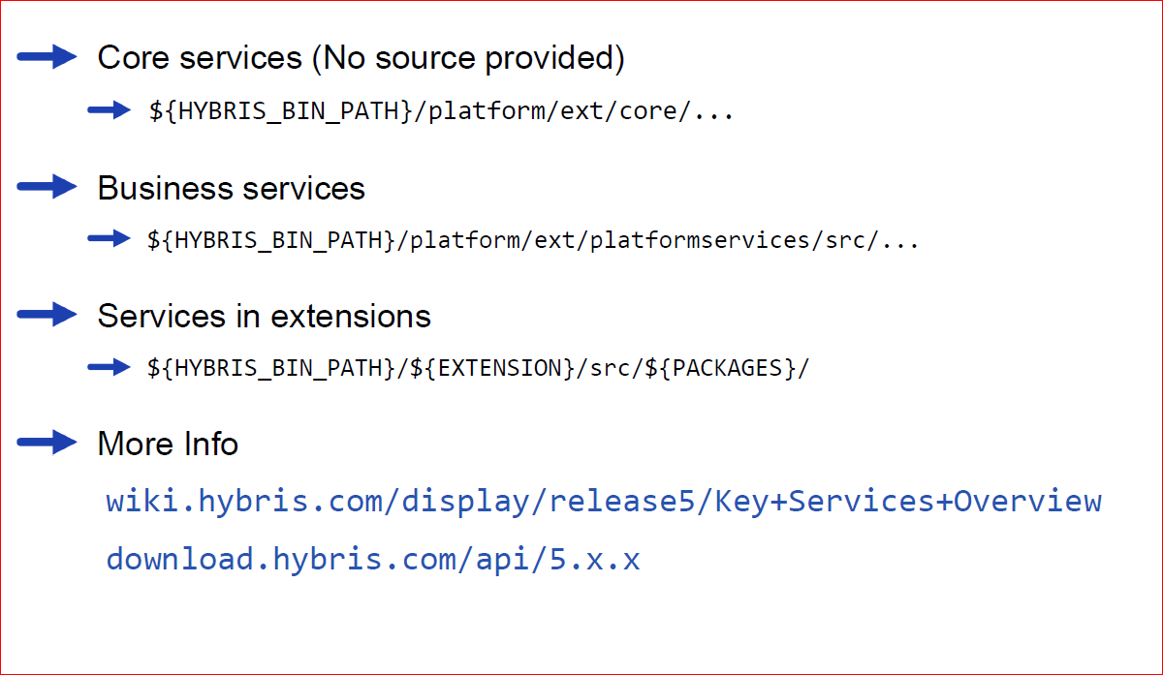
Where to Find Services

Slide 8
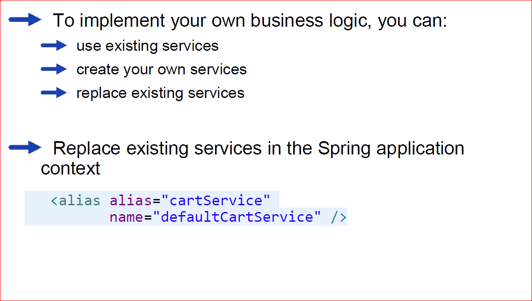
Using Services

Slide 9
Contents
Architecture of the ServiceLayer
Services
Models
Interceptors
Events

Slide 10
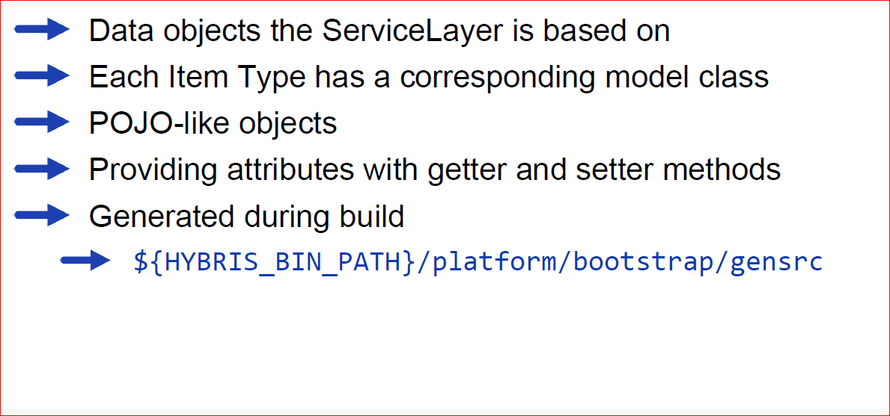
Overview of Models (I)

Slide 11
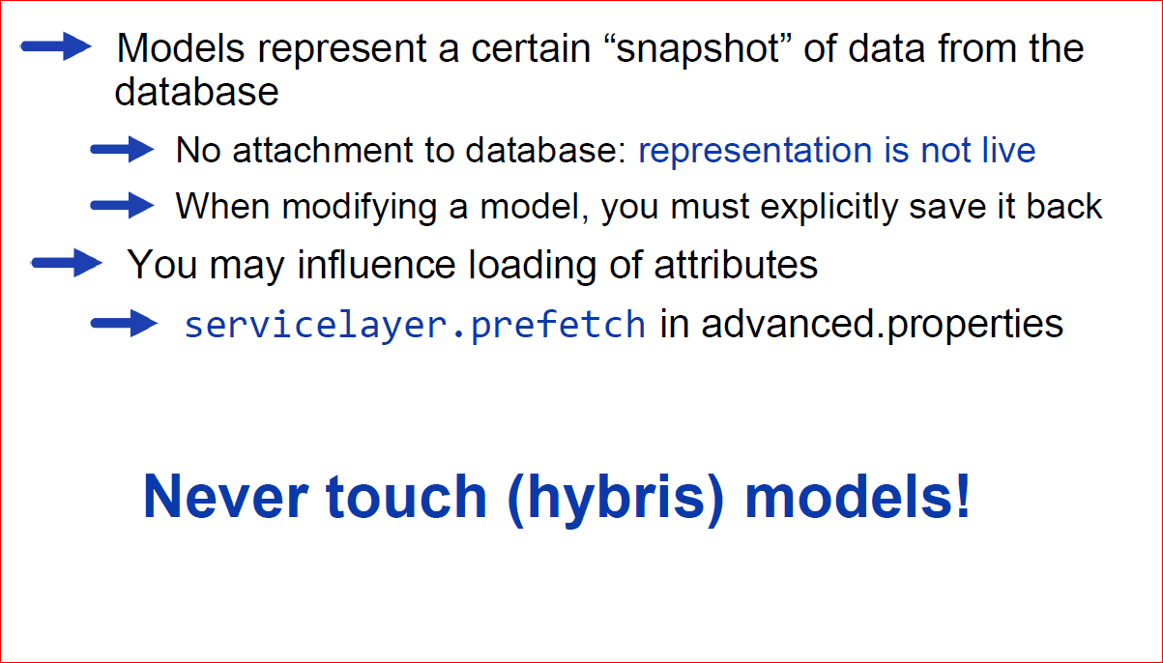
Overview of Models (II)

Slide 12
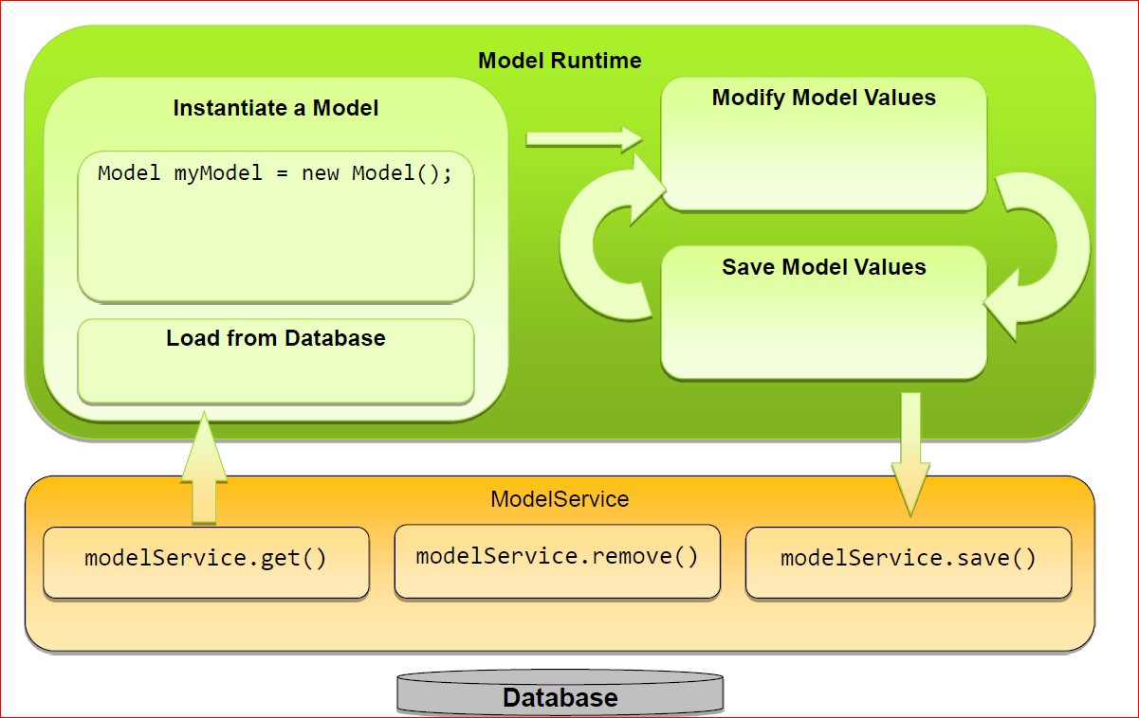
Lifecycle of a Model

Slide 13
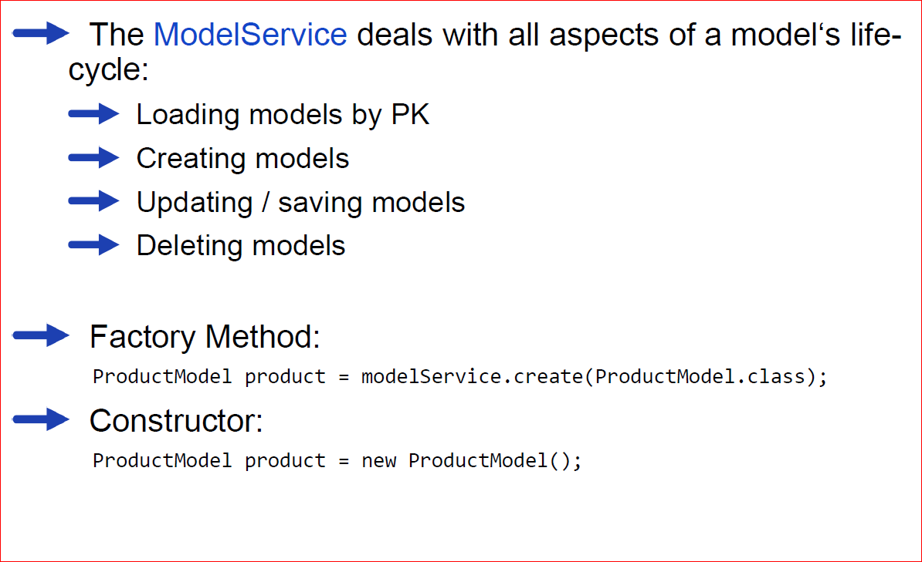
Using Models

Slide 14
Contents
Architecture of the ServiceLayer
Services
Models
Interceptors
Events

Slide 15
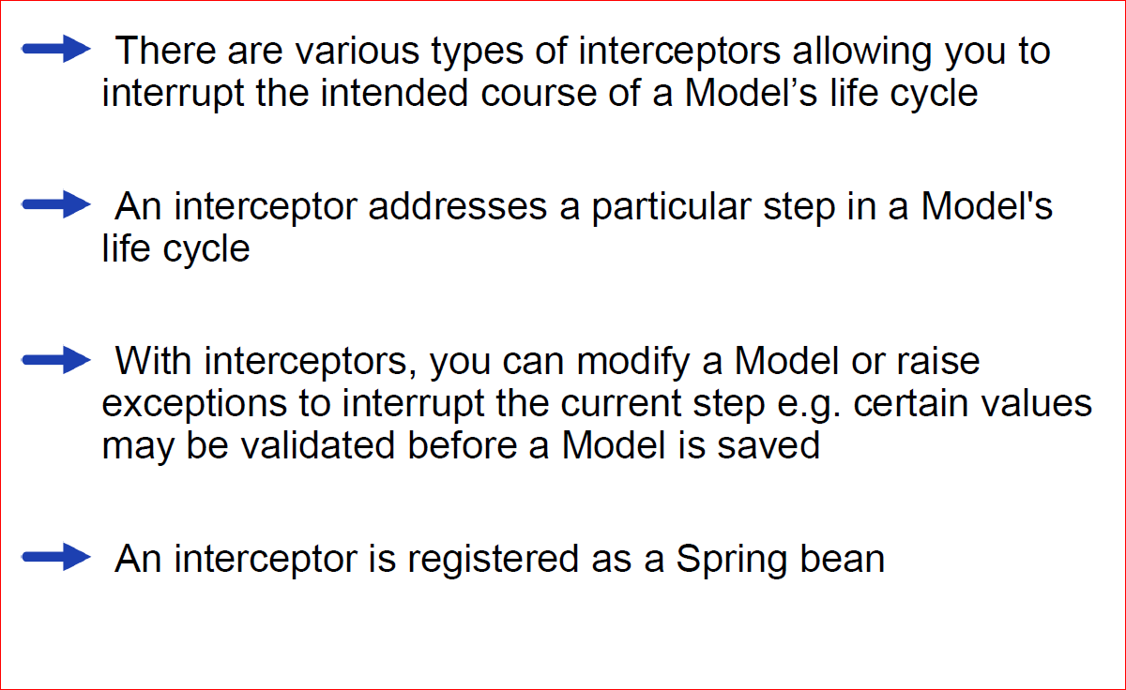
Interceptors Overview

Slide 16
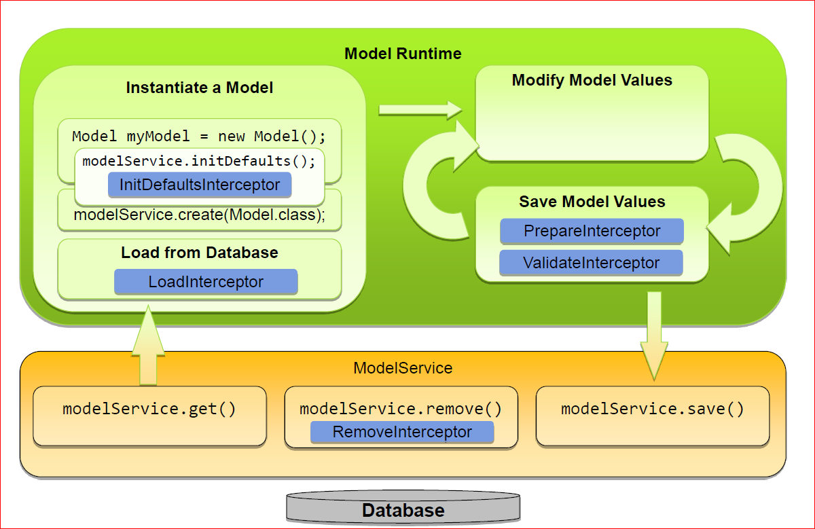
Interceptors Overview - Lifecycle of a Model

Slide 17
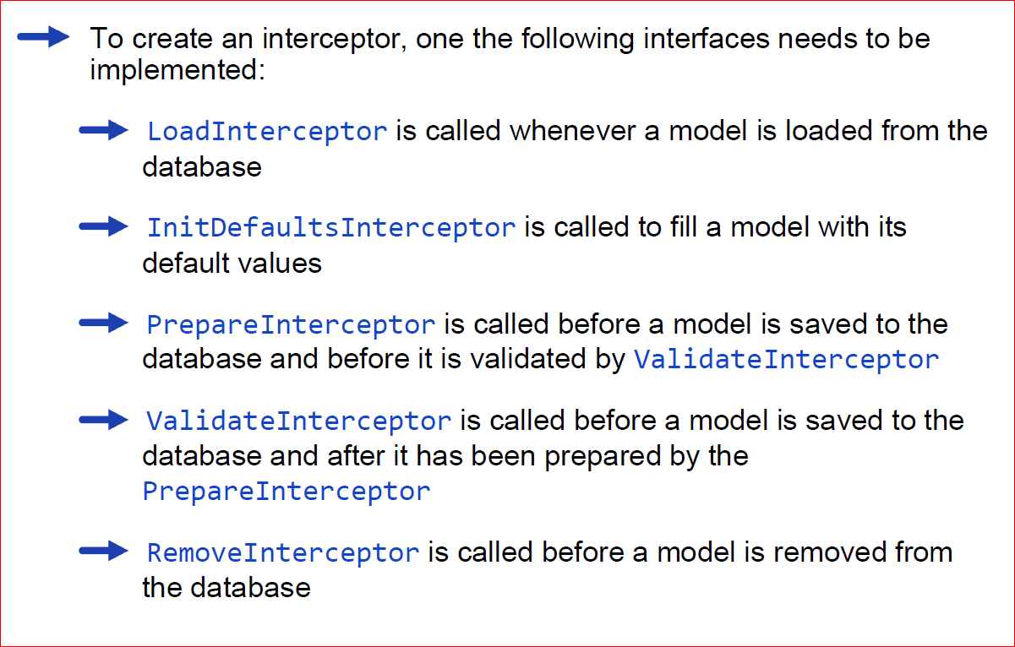
Implementing interceptors

Slide 18
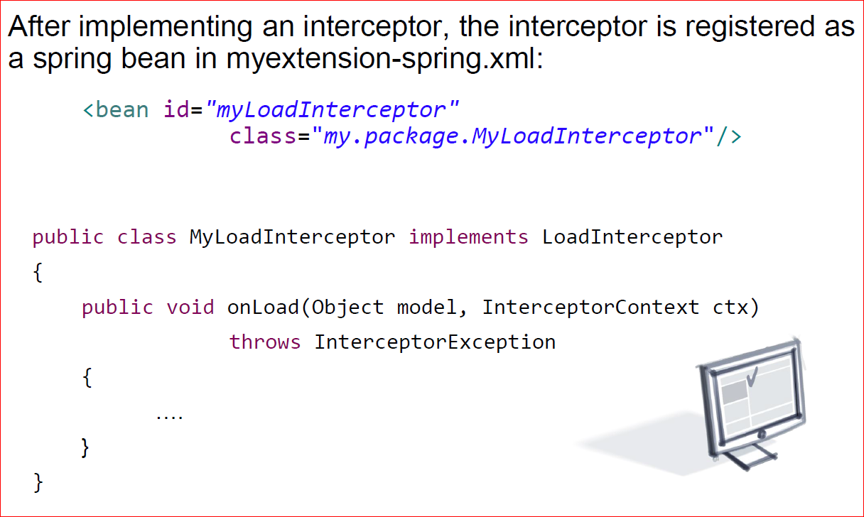
Implementation - Registering an interceptor

Slide 19
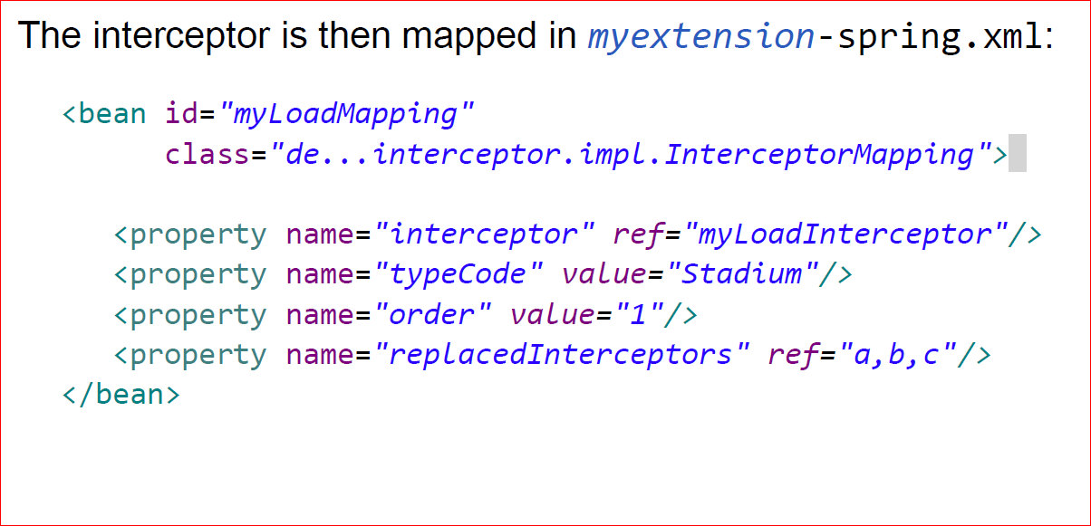
Implementation – mapping the interceptor

Slide 20
Contents
Architecture of the ServiceLayer
Services
Models
Interceptors
Events

Slide 21
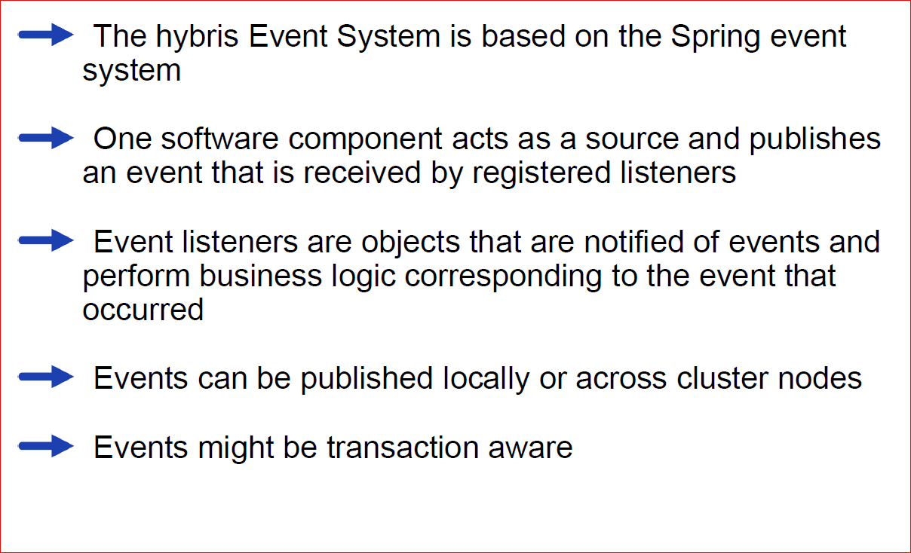
The Event System – Overview

Slide 22
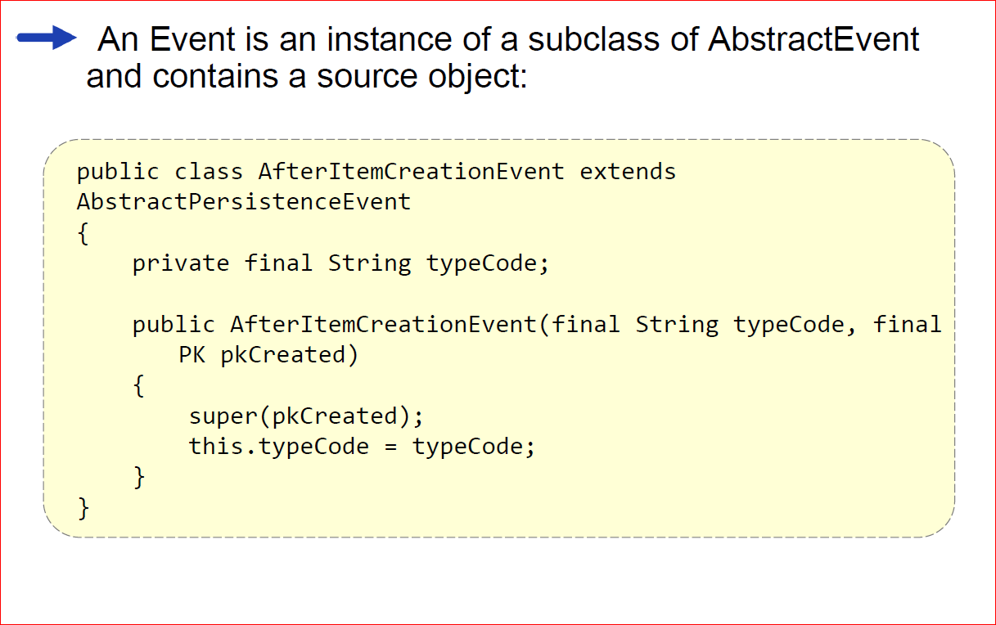
Implementing Events

Slide 23
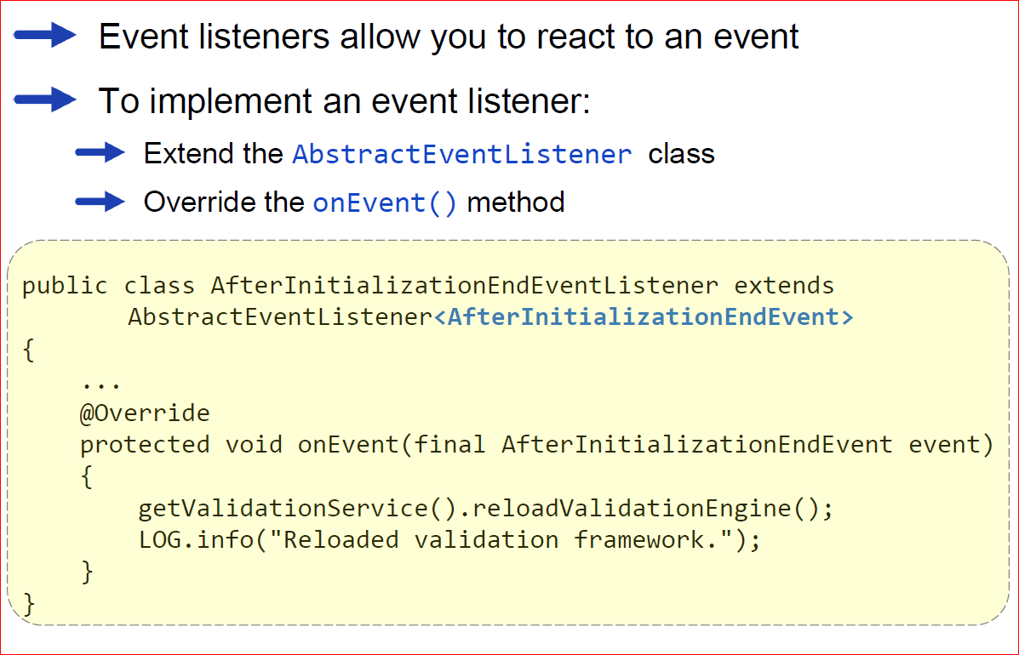
Implementing Event Listeners

Slide 24
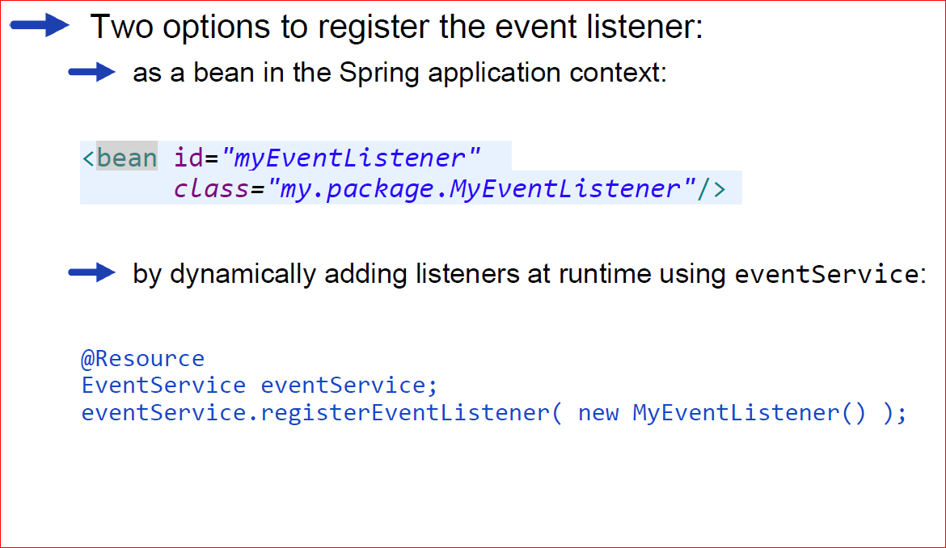
Registering Event Listeners

Slide 25
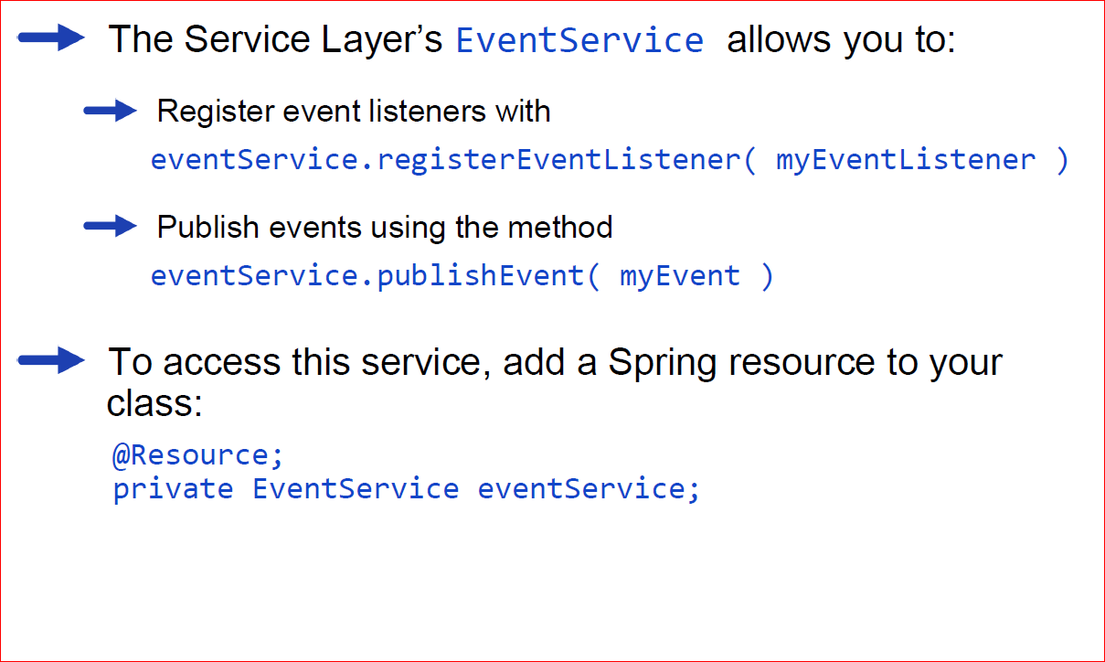
Event Service

Slide 26
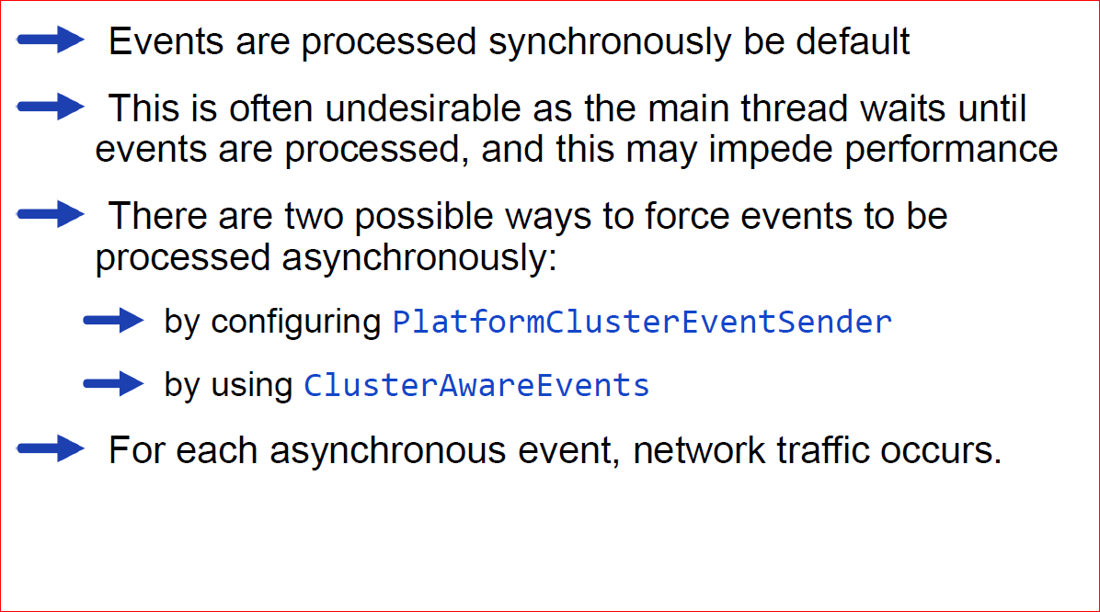
Asynchronous events

Slide 27
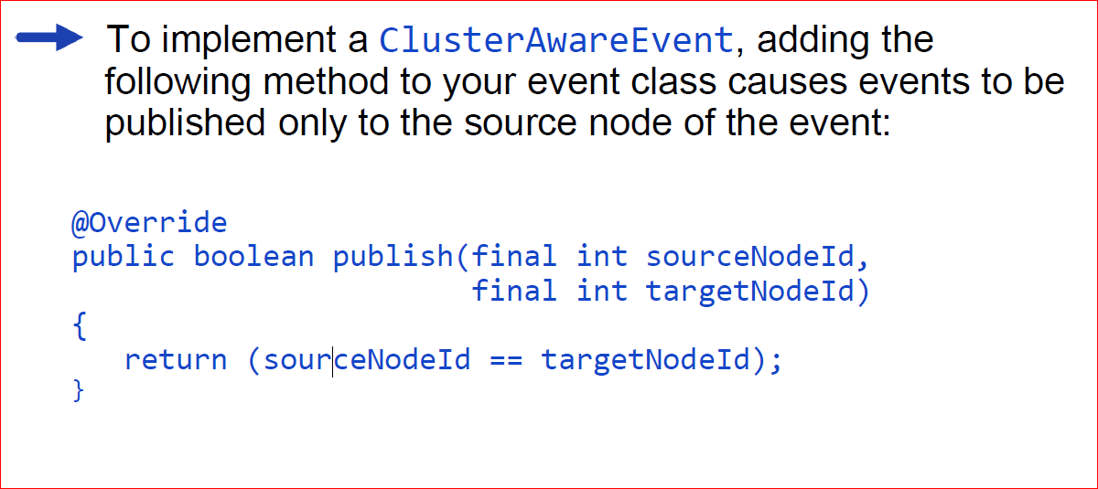
Asynchronous events - Implementing ClusterAwareEvent

Slide 28
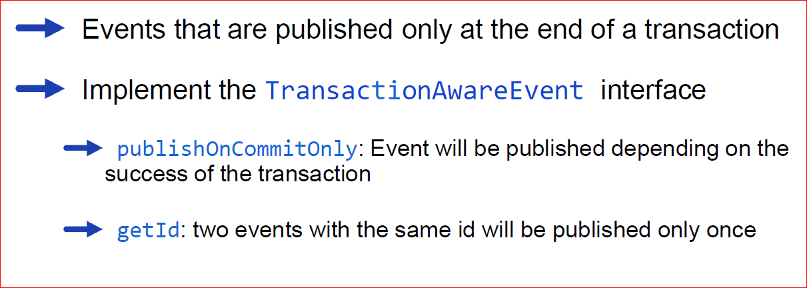
Transaction-Aware Events

Slide 29
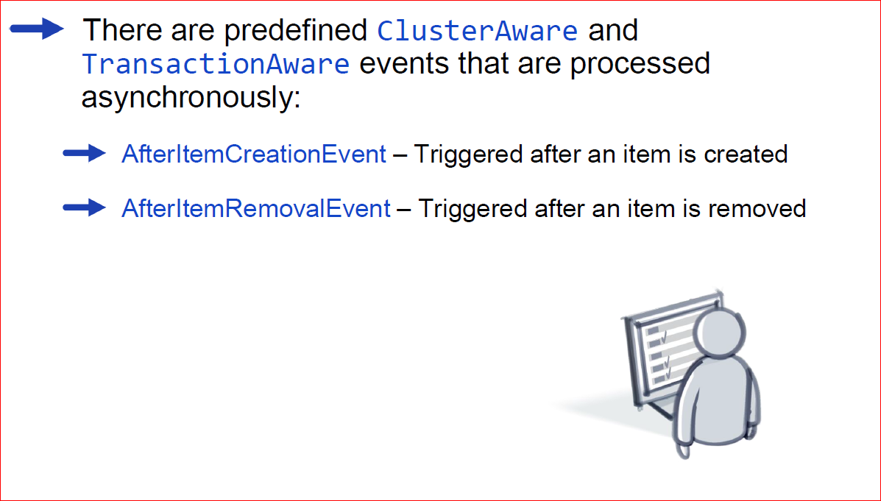
Predefined Events – ClusterAware and TransactionAware Events

Slide 30
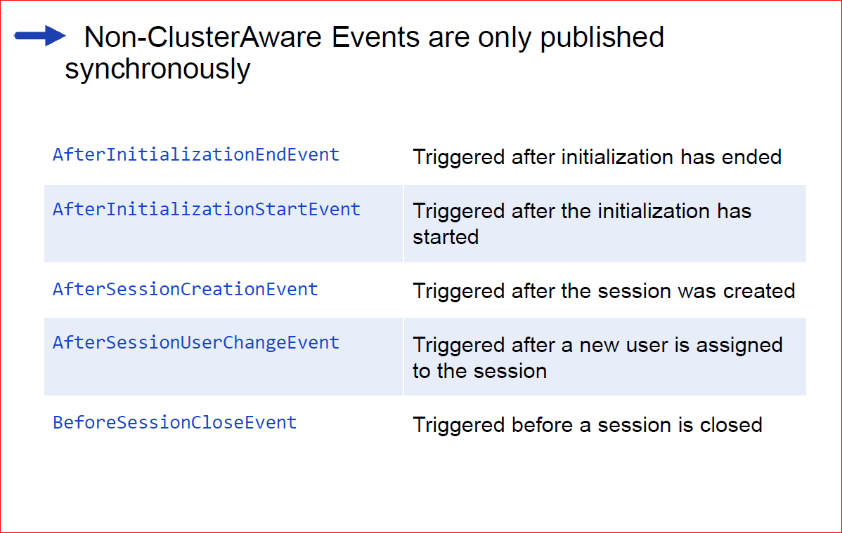
Predefined Events – Non-Cluster Aware Events

Slide 31
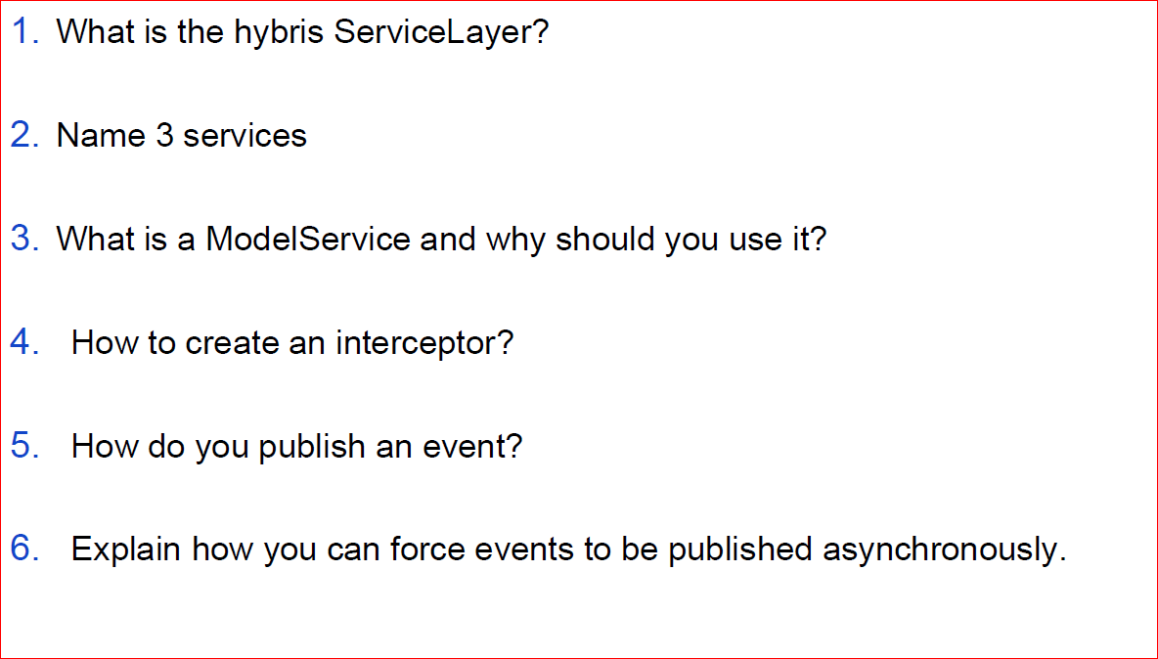
Quizees

